Slide 1
Classification
Part 3
CME4416 – Introduction to Data Mining

Slide 2
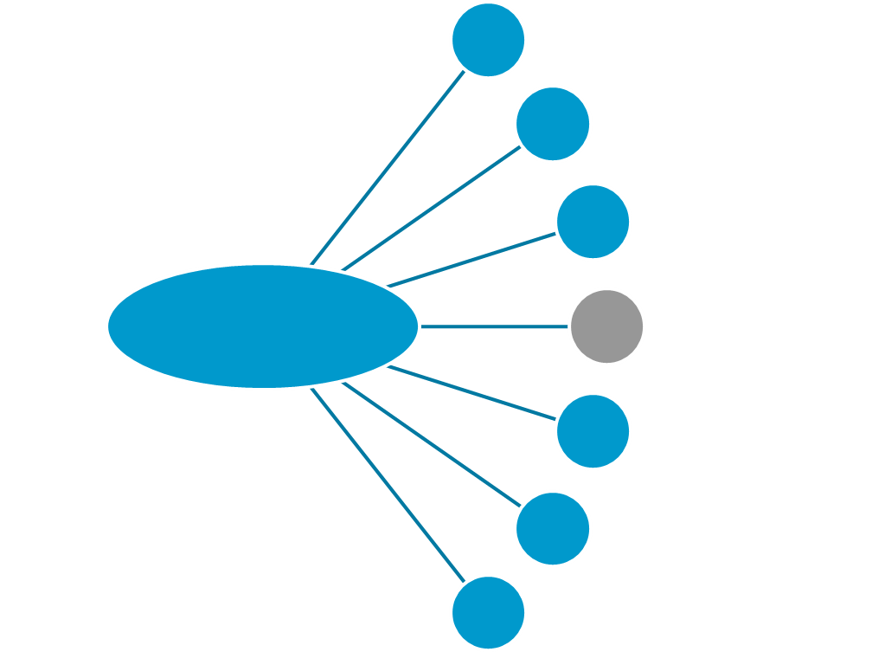
Classification Techniques
Decision Trees
Bayesian Classification
K-Nearest Neighbor
Classification
Neural Network
Support Vector Machines (SVM)
Fuzzy Set Approaches
…

Slide 3
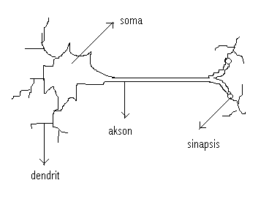

Human Brain
The human brain has been estimated to contain 50–100 billion neurons
A neuron
  Soma (Cell has a nucleus)
  Dendrites
  Axon
  Synapses
Chemical synapse between an axon of one neuron and a dendrite of another
  Connections per neuron ~ 10⁴⁻⁵

Slide 4
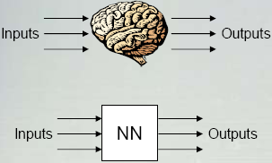
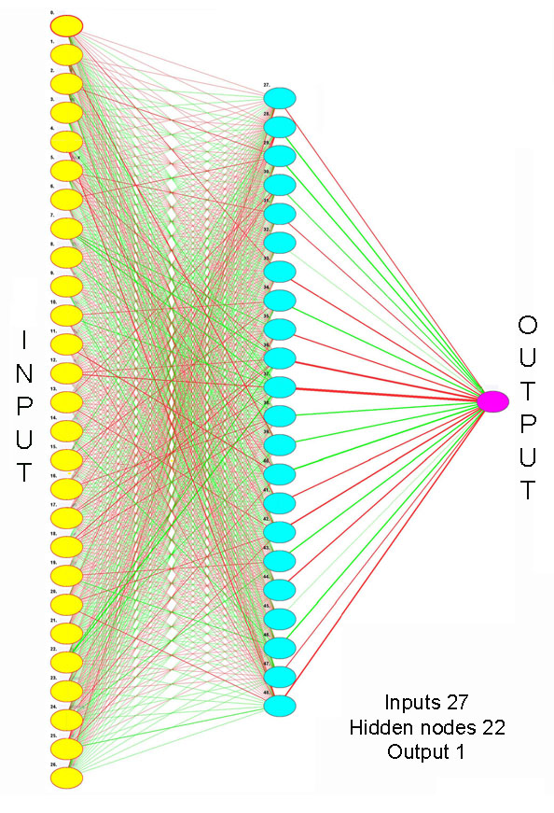
Neural Network
Neural Network: A set of connected input/output units (neurons) where each connection has a weight associated with it.
Based on observed functioning of human brain.
NNs, like people, learn by example.

Slide 5
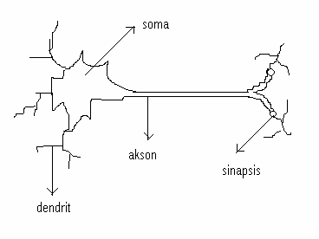
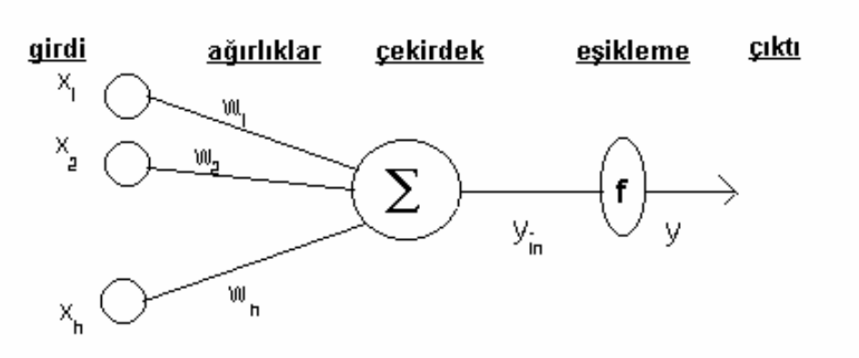
Neural Network
Biological Neuron | Neural Network
Dendrit | Inputs | X_{h}
Synapses | Weights | W_{h}
Nucleus | Processing Element | Σ
Cell Body (Soma) | Activation Function | f
Axon | Output | y

Slide 6
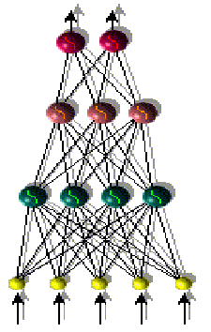
Applications
Pattern Recognition (Image / Speech) (text, numbers, faces)
Data Mining
  Classification and Prediction
  Outlier Detection
Marketting
  Stock value forecast
  Predicting time-series in financial world
  Identifying valuable customers
Medical
  Diagnosing medical conditions
Telecommunication
Automation and Control (Robotics)
Others
  Classification of galaxies
  Forecast of energy consumption

Slide 7


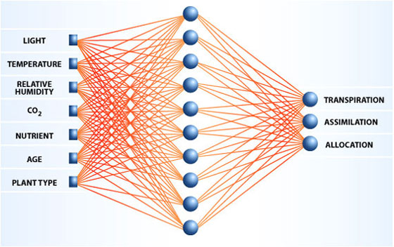
NN Example - Green factories
A plant produces food, oxygen, and water varies with the kind of plant, its age, and assorted environmental conditions.
The relationships are complex, nonlinear, and dynamic.
Data about how plants perform under specific sets of conditions, and infers how various other combinations of conditions would affect that behavior.
Output:
  photosynthesis rate,
  transpiration rate (release of water),
  The proportion of its biomass that is edible
NN draws relationships between
  the plants' performance
  the kind of plant, age, and environmental factors
For example, if NN knows how much oxygen, food, and water the plants produced at 22ºC, 26ºC, and 30ºC, it can estimate how much they would produce at temperatures between 22º and 26º, and between 26º and 30º.
Rutgers University

Slide 8
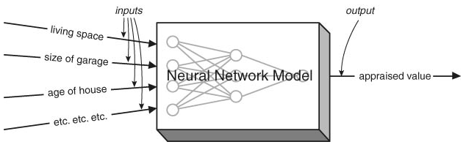
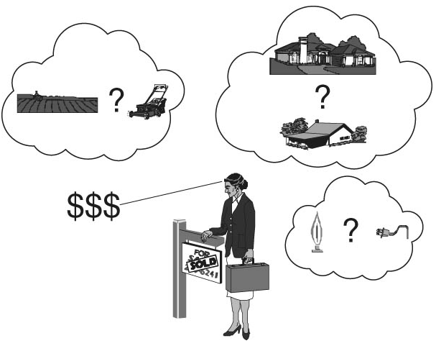
NN Example - Real Estate Appraiser
Loan Prospector – HNC/Fair Isaac

Slide 9
NN Models
sparsely connected
fully connected

Slide 10
NN Models
Feedforward NN: Connections between the units do not form a directed cycle.
Recurrent NN: Connections between units form a directed cycle.
Feedforward NN
Recurrent NN

Slide 11
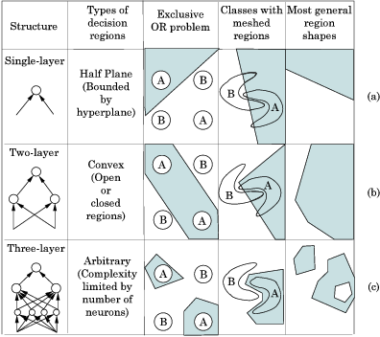
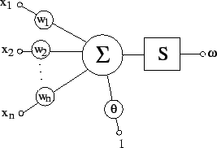
NN Models
Single layer
Multiple layer
perceptron

Slide 12
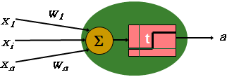







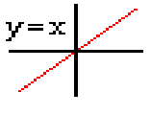
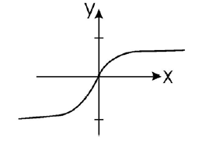

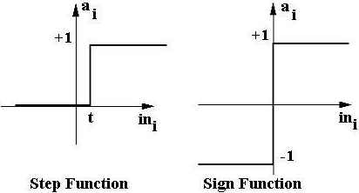
Activation Functions
Unit Step
Sigmoid
Gaussian
Hiberbolik Tanjant
Piecewise Linear
Identity
f (x) = x
f(s) = (1 – exp(-2s))/ (1 +exp(-2s))

Slide 13


Activation Function Example
Training Data
Unit Step
Input | Output
3 1 0 -2 | 1
0 10 0 0 | 0
… | …
3
0.3
3
0.3
0
0.3
1
-0.1
1
-0.1
10
-0.1
3
-1
2.1
2.1
2.1
0
0
0
-1.1
-1.1
-1.1
-2
-2
0
Input: (3, 1, 0, -2)
Processing:
3(0.3) + 1(-0.1) + 0(2.1) + -1.1(-2)
= 0.9 + (-0.1) + 2.2
Output: 3

Slide 14
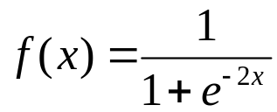
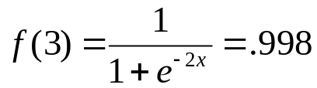
Activation Function Example
Sigmoid
Training Data
Β=2
Input | Output
3 1 0 -2 | 1
0 10 0 0 | 0
… | …
3
0.3
3
0.3
1
-0.1
1
-0.1
2.1
2.1
3
0
0
-1.1
-1.1
-2
-2
Input: (3, 1, 0, -2)
Processing:
3(0.3) + 1(-0.1) + 0(2.1) + -1.1(-2)
= 0.9 + (-0.1) + 2.2
Output: 3

Slide 15



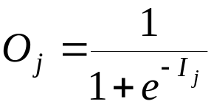
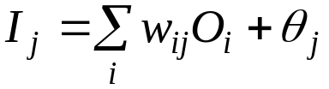
Classification by NN
For each training tuple, the weights are modified to minimize the mean squared error.
A more typical NN
Output vector
Output layer
Hidden layer
w_{ij}
Input layer
Input vector: X

Slide 16
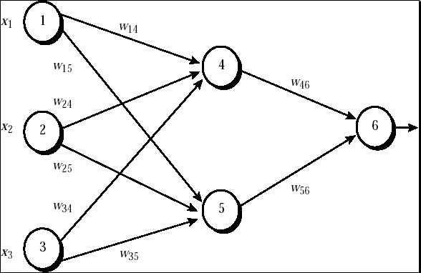
Classification by NN
1
1
1
-0.2
-0.2
-0.7
-0.7
0.33
0.4
0.4
0
0
-0.5
0
-0.5
0,6
1
1
1
1
1
0.33
0.33
Correct Output: 0.6
0.474
0
0
Update the weights and bias values
0.525
0.525
1
1

Slide 17
Multiple-Layer Networks and
Backpropagation Algorithms
This section presents the architecture of the network that is most commonly used with the backpropagation algorithm –
the multilayer feedforward network

Slide 18
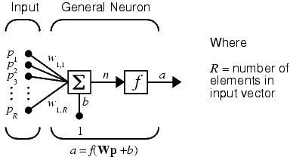
Architecture
Neuron Model
An elementary neuron with R inputs is shown below. Each input is weighted with an appropriate w. The sum of the weighted inputs and the bias forms the input to the transfer function f. Neurons can use any differentiable transfer function f to generate their output.

Slide 19
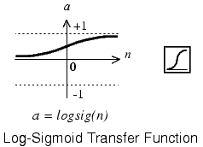
Architecture Neuron Model
Transfer Functions (Activation Function)
Multilayer networks often use the log-sigmoid transfer function logsig.
The function logsig generates outputs between 0 and 1 as the neuron's net input goes from negative to positive infinity

Slide 20

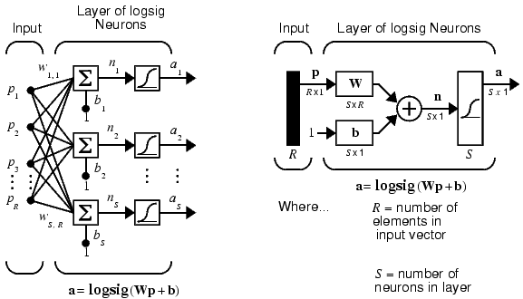
Architecture
Feedforward Network
A single-layer network of S logsig neurons having R inputs is shown below in full detail on the left and with a layer diagram on the right.

Slide 21
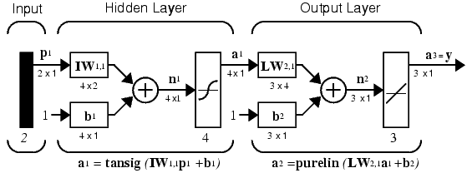
Architecture
Feedforward Network
- Feedforward networks often have one or more hidden layers of sigmoid neurons followed by an output layer of linear neurons.
- Multiple layers of neurons with nonlinear transfer functions allow the network to learn nonlinear and linear relationships between input and output vectors.
- The linear output layer lets the network produce values outside the range -1 to +1. On the other hand, if you want to constrain the outputs of a network (such as between 0 and 1), then the output layer should use a sigmoid transfer function (such as logsig).

Slide 22
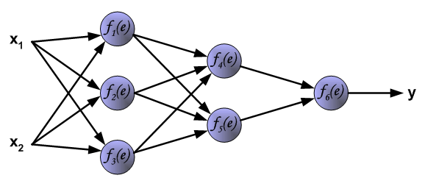
Learning Algorithm:
Backpropagation
The following slides describes teaching process of multi-layer neural network employing backpropagation algorithm.
To illustrate this process the three layer neural network with two inputs and one output, which is shown in the picture below, is used:

Slide 23
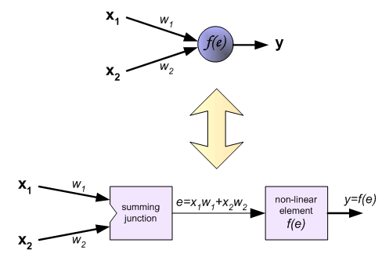
Learning Algorithm:
Backpropagation
Each neuron is composed of two units.
First unit adds products of weights coefficients and input signals.
The second unit realise nonlinear function, called neuron transfer (activation) function. Signal e is adder output signal, and y = f(e) is output signal of nonlinear element. Signal y is also output signal of neuron.

Slide 24
Learning Algorithm:
Backpropagation
To teach the neural network we need training data set. The training data set consists of input signals (x₁ and x₂ ) assigned with corresponding target (desired output) z.
The network training is an iterative process. In each iteration weights coefficients of nodes are modified using new data from training data set. Modification is calculated using algorithm described below:
Each teaching step starts with forcing both input signals from training set. After this stage we can determine output signals values for each neuron in each network layer.

Slide 25
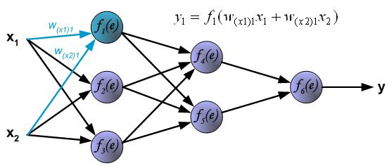
Learning Algorithm:
Backpropagation
Pictures below illustrate how signal is propagating through the network, Symbols w_{(xm)n} represent weights of connections between network input x_{m} and neuron n in input layer. Symbols y_{n} represents output signal of neuron n.

Slide 26
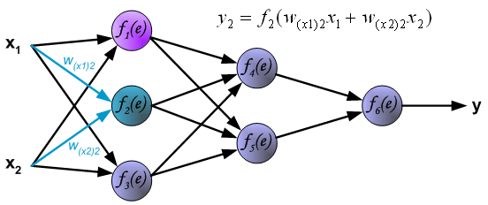
Learning Algorithm:
Backpropagation

Slide 27
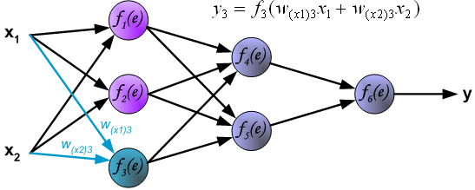
Learning Algorithm:
Backpropagation

Slide 28
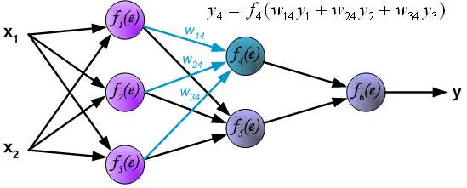
Learning Algorithm:
Backpropagation
Propagation of signals through the hidden layer. Symbols w_{mn} represent weights of connections between output of neuron m and input of neuron n in the next layer.

Slide 29
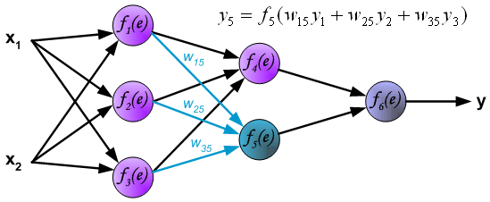
Learning Algorithm:
Backpropagation

Slide 30
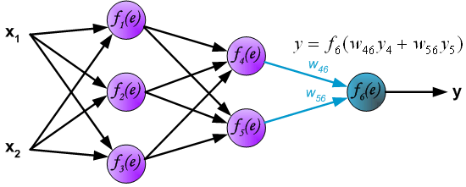
Learning Algorithm:
Backpropagation
Propagation of signals through the output layer.

Slide 31
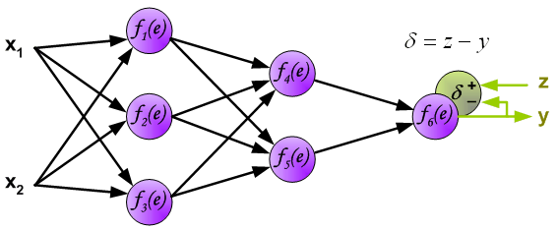
Learning Algorithm:
Backpropagation
In the next algorithm step the output signal of the network y is compared with the desired output value (the target), which is found in training data set. The difference is called error signal d of output layer neuron

Slide 32
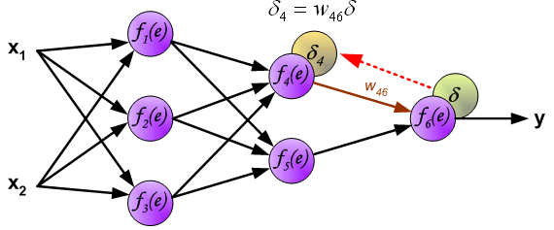
Learning Algorithm:
Backpropagation
The idea is to propagate error signal d (computed in single teaching step) back to all neurons, which output signals were input for discussed neuron.

Slide 33
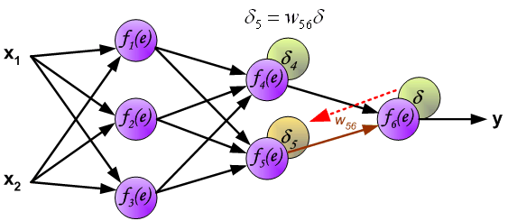
Learning Algorithm:
Backpropagation
The idea is to propagate error signal d (computed in single teaching step) back to all neurons, which output signals were input for discussed neuron.

Slide 34
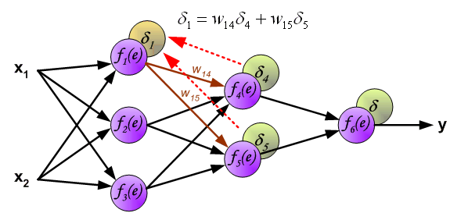
Learning Algorithm:
Backpropagation
The weights' coefficients w_{mn} used to propagate errors back are equal to this used during computing output value. Only the direction of data flow is changed (signals are propagated from output to inputs one after the other).
This technique is used for all network layers. If propagated errors came from few neurons they are added. The illustration is below:

Slide 35
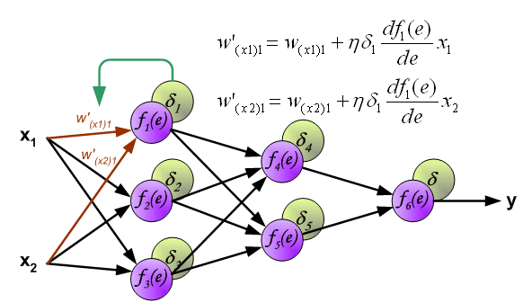
Learning Algorithm:
Backpropagation
When the error signal for each neuron is computed, the weights coefficients of each neuron input node may be modified. In formulas below df(e)/de represents derivative of neuron activation function (which weights are modified).

Slide 36
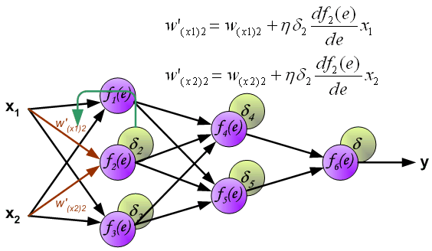
Learning Algorithm:
Backpropagation
When the error signal for each neuron is computed, the weights coefficients of each neuron input node may be modified. In formulas below df(e)/de represents derivative of neuron activation function (which weights are modified).

Slide 37
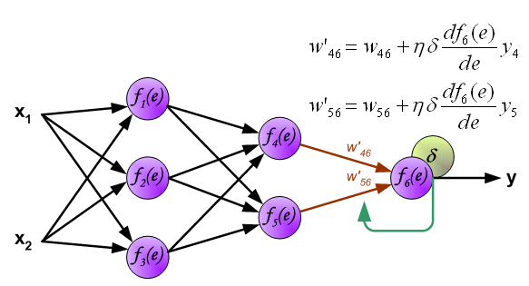
Learning Algorithm:
Backpropagation
When the error signal for each neuron is computed, the weights coefficients of each neuron input node may be modified. In formulas below df(e)/de represents derivative of neuron activation function (which weights are modified).

Slide 38
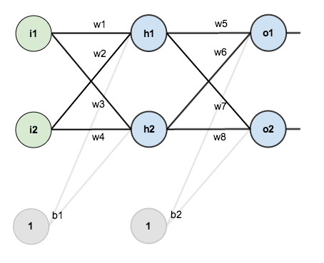
Backpropagation Example
A neural network with two inputs, two hidden neurons, two output neurons. Additionally, the hidden and output neurons will include a bias.

Slide 39
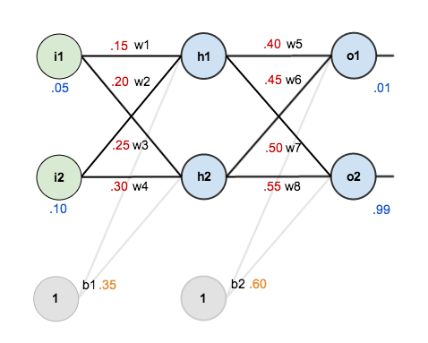
Backpropagation Example
the initial weights, the biases, and training inputs/outputs:

Slide 40
The Forward Pass
total net input to each hidden layer neuron, squash the total net input using an activation function (here we use the logistic function), then repeat the process with the output layer neurons.
calculate the total net input for h1:
then squash it using the logistic function to get the output of h1:
Carrying out the same process for h2:

Slide 41
The Forward Pass
repeat this process for the output layer neurons, using the output from the hidden layer neurons as inputs.
the output for o1:
carrying out the same process for o2:

Slide 42
The Forward Pass
Calculating the Total Error (squared error function)
the target output for o1 is 0.01 but the neural network output 0.75136507, therefore its error is:
Repeating this process for o2 (remembering that the target is 0.99) :
The total error for the neural network is the sum of these errors:

Slide 43
The Backwards Pass
The goal with backpropagation is to update each of the weights in the network so that they cause the actual output to be closer the target output,
thereby minimizing the error for each output neuron and the network as a whole.

Slide 44


The Backwards Pass: Output Layer
Consider w5: to know how much a change in w5 affects the total error, aka
Chain rule:

Slide 45
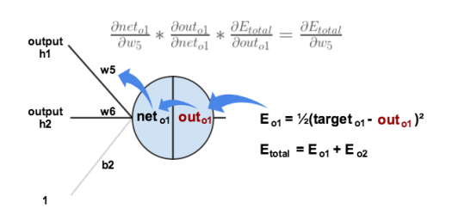
The Backwards Pass: Output Layer

Slide 46
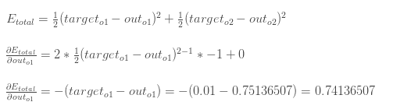
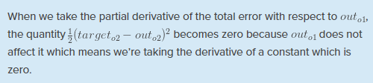
The Backwards Pass: Output Layer
First, how much does the total error change with respect to the output?
-(target - out) is sometimes expressed as out – target

Slide 47

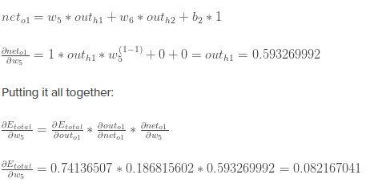
The Backwards Pass: Output Layer
Next, how much does the output of change with respect to its total net input?
Finally, how much does the total net input of o1 change with respect to w5?

Slide 48
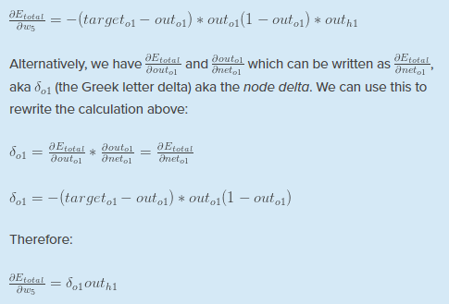
The Backwards Pass: Output Layer
Delta rule:

Slide 49
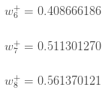
The Backwards Pass: Output Layer
To decrease the error, subtract this value from the current weight (optionally multiplied by some learning rate, eta, which is set to 0.5 here):
repeat this process to get the new weights w6, w7, and w8:
Perform the actual updates in the neural network after having the new weights leading into the hidden layer neurons (ie, use the original weights, not the updated weights, when continue the backpropagation algorithm for hidden layers).

Slide 50
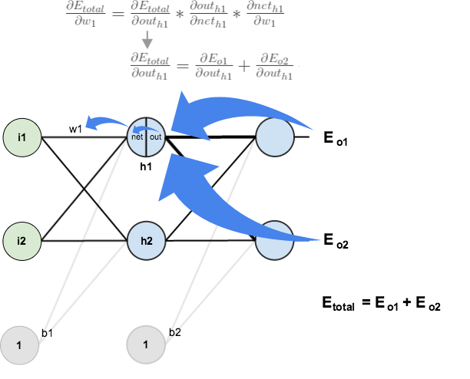
The Backwards Pass: Hidden Layer
Next, continue the backwards pass by calculating new values for w1, w2, w3, and w4.

Slide 51
The Backwards Pass: Hidden Layer
Use a similar process as for the output layer,
but slightly different to account for the fact that the output of each hidden layer neuron contributes to the output (and therefore error) of multiple output neurons.
out_h1 affects both out_o1 and out_o2 therefore the
needs to take into consideration its effect on the both output neurons:

Slide 52
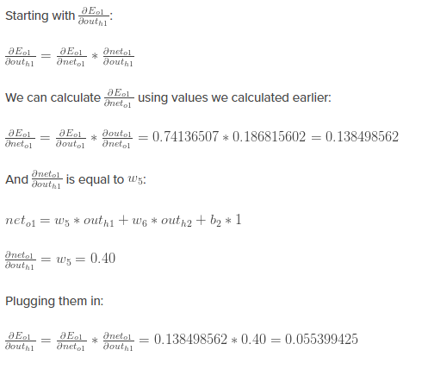
The Backwards Pass: Hidden Layer

Slide 53


The Backwards Pass: Hidden Layer

Slide 54

The Backwards Pass: Hidden Layer
calculate the partial derivative of the total net input to h1 with respect to w1 the same as for the output neuron:

Slide 55

The Backwards Pass: Hidden Layer
Also written as:
Now update w1:
Repeating this for w2,w3,w4:

Slide 56
The Backwards Pass: Hidden Layer
All weights has been updated!
When feed forward the 0.05 and 0.1 inputs originally, the error on the network was 0.298371109.
After this first round of backpropagation, the total error is now down to 0.291027924.
It might not seem like much, but after repeating this process 10,000 times, for example, the error plummets to 0.0000351085.
At this point, when feed forward 0.05 and 0.1, the two outputs neurons generate 0.015912196 (vs 0.01 target) and 0.984065734 (vs 0.99 target).

Slide 57



Slide 58
Questions?

Slide 59
Acknowledgements
Asst. Prof. Dr. Derya BİRANT
https://mattmazur.com/2015/03/17/a-step-by-step-backpropagation-example/

